Slide 1
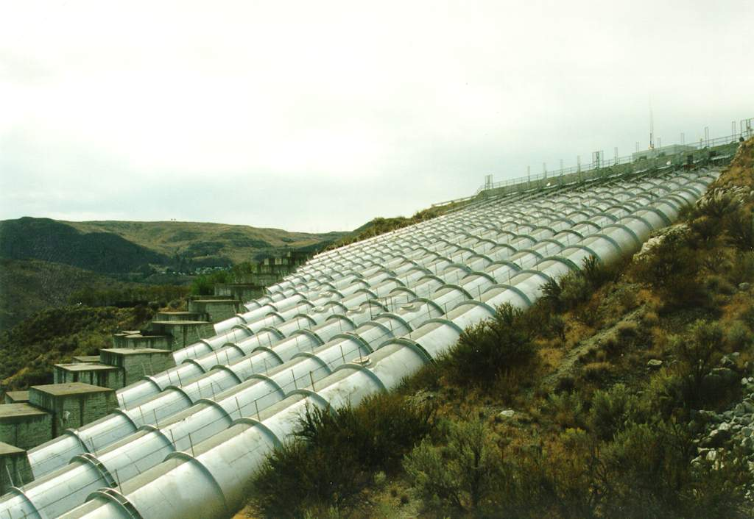
Closed Conduit Flow
CEE 332

Slide 2
Closed Conduit Flow
Energy equation
EGL and HGL
Head loss
major losses
minor losses
Non circular conduits

Slide 3
Conservation of Energy
Kinetic, potential, and thermal energy
h_{p} =
head supplied by a pump
h_{t} =
head given to a turbine
h_{L} =
mechanical energy converted to thermal
downstream
Cross section 2 is ____________ from cross section 1!
Point to point or control volume?
irreversible
V is average velocity, kinetic energy
Why α? _____________________________________

Slide 4
Energy Equation Assumptions
Pressure is _________ in both cross sections
pressure changes are due to elevation only
section is drawn perpendicular to the streamlines (otherwise the _______ energy term is incorrect)
Constant ________at the cross section
_______ flow
hydrostatic
kinetic
density
Steady

Slide 5
EGL (or TEL) and HGL
pressure
head (w.r.t. reference pressure)
elevation
head (w.r.t. datum)
velocity
head
downward
The energy grade line must always slope ___________ (in direction of flow) unless energy is added (pump)
The decrease in total energy represents the head loss or energy dissipation per unit weight
EGL and HGL are coincident and lie at the free surface for water at rest (reservoir)
If the HGL falls below the point in the system for which it is plotted, the local pressures are _____ ____ __________ ______
lower than reference pressure

Slide 6
Energy equation
Energy Grade Line
velocity head
Hydraulic G L
static head
pressure head
Why is static head important?
z
elevation
pump
z = 0
datum

Slide 7
Bernoulli Equation Assumption
_________ (viscosity can’t be a significant parameter!)
Along a __________
______ flow
Constant ________
No pumps, turbines, or head loss
Frictionless
streamline
Steady
density
Why no α? ____________
point velocity
Does direction matter? ____
no
Useful when head loss is small

Slide 8
Pipe Flow: Review
We have the control volume energy equation for pipe flow.
We need to be able to predict the relationship between head loss and flow.
How do we get this relationship? __________ _______.
dimensional analysis

Slide 9
Flow Profile for Delaware Aqueduct
Rondout Reservoir
(EL. 256 m)
70.5 km
West Branch Reservoir
(EL. 153.4 m)
Sea Level
(Designed for 39 m³/s)
Need a relationship between flow rate and head loss

Slide 10
Ratio of Forces
Create ratios of the various forces
The magnitude of the ratio will tell us which forces are most important and which forces could be ignored
Which force shall we use to create the ratios?

Slide 11
Inertia as our Reference Force
F=ma
Fluids problems (except for statics) include a velocity (V), a dimension of flow (l), and a density (ρ)
Substitute V, l, ρ for the dimensions MLT
Substitute for the dimensions of specific force

Slide 12
Dimensionless Parameters
Reynolds Number
Froude Number
Weber Number
Mach Number
Pressure/Drag Coefficients
(dependent parameters that we measure experimentally)

Slide 13
Problem solving approach
Identify relevant forces and any other relevant parameters
If inertia is a relevant force, than the non dimensional Re, Fr, W, M, Cp numbers can be used
If inertia isn’t relevant than create new non dimensional force numbers using the relevant forces
Create additional non dimensional terms based on geometry, velocity, or density if there are repeating parameters
If the problem uses different repeating variables then substitute (for example ωd instead of V)
Write the functional relationship

Slide 14
Pipe Flow: Dimensional Analysis
What are the important forces? ______, ______,________. Therefore ________number and _______________ .
What are the important geometric parameters? _________________________
Create dimensionless geometric groups ______, ______
Write the functional relationship
Inertial
viscous
pressure
Reynolds
Pressure coefficient
diameter, length, roughness height
l/D
ε/D
Other repeating parameters?

Slide 15
Dimensional Analysis
How will the results of dimensional analysis guide our experiments to determine the relationships that govern pipe flow?
If we hold the other two dimensionless parameters constant and increase the length to diameter ratio, how will C_{p} change?
Cp proportional to l
f is friction factor

Slide 16
Pressure Coefficient and Head Loss
Dimensional Analysis
More general
Assume horizontal flow
Definition of f!
Always true (laminar or turbulent)
Darcy-Weisbach
Darcy-Weisbach equation

Slide 17
Friction Factor : Major losses
Laminar flow
Hagen-Poiseuille
Turbulent (Smooth, Transition, Rough)
Colebrook Formula
Moody diagram
Swamee-Jain

Slide 18
Laminar Flow Friction Factor
Hagen-Poiseuille
Darcy-Weisbach
-1
Slope of ___ on log-log plot

Slide 19
Turbulent Pipe Flow Head Loss
___________ to the length of the pipe
Proportional to the _______ of the velocity (almost)
________ with surface roughness
Is a function of density and viscosity
Is __________ of pressure
Proportional
square
Increases
independent

Slide 20
Smooth, Transition, Rough Turbulent Flow
Hydraulically smooth pipe law (von Karman, 1930)
Rough pipe law (von Karman, 1930)
Transition function for both smooth and rough pipe laws (Colebrook)
(used to draw the Moody diagram)

Slide 21
Moody Diagram
0.1
0.05
0.04
0.03
0.02
0.015
0.01
0.008
friction factor
0.006
0.004
laminar
0.002
0.001
0.0008
0.0004
0.0002
0.0001
0.01
0.00005
smooth
1E+03
1E+04
1E+05
1E+06
1E+07
1E+08
Re

Slide 22
Swamee-Jain
1976
limitations
ε/D < 2 x 10⁻²
Re >3 x 10³
less than 3% deviation from results obtained with Moody diagram
easy to program for computer or calculator use
no f
L
h_{f}
Each equation has two terms. Why?

Slide 23
Swamee-Jain gets an f
The challenge that S-J solved was deriving explicit equations that are independent of the unknown parameter.
3 potential unknowns (flow, head loss, or diameter): 3 equations for f
that can then be combined with the Darcy Weisbach equation

Slide 24
Colebrook Solution for Q

Slide 25
Colebrook Solution for Q

Slide 26
Swamee D?

Slide 27
Pipe Roughness
pipe material
pipe roughness
ε
(mm)
glass, drawn brass, copper
0.0015
commercial steel or wrought iron
0.045
asphalted cast iron
0.12
galvanized iron
0.15
cast iron
0.26
concrete
0.18-0.6
rivet steel
0.9-9.0
corrugated metal
45
PVC
0.12

Slide 28
Solution Techniques
find head loss given (D, type of pipe, Q)
find flow rate given (head, D, L, type of pipe)
find pipe size given (head, type of pipe,L, Q)

Slide 29
Exponential Friction Formulas
Commonly used in commercial and industrial settings
Only applicable over _____ __ ____ collected
Hazen-Williams exponential friction formula
range of data
C = Hazen-Williams coefficient

Slide 30
Head loss: Hazen-Williams Coefficient
C Condition
150 PVC
140 Extremely smooth, straight pipes; asbestos cement
130 Very smooth pipes; concrete; new cast iron
120 Wood stave; new welded steel
110 Vitrified clay; new riveted steel
100 Cast iron after years of use
95 Riveted steel after years of use
60-80 Old pipes in bad condition

Slide 31
Hazen-Williams vs Darcy-Weisbach
Both equations are empirical
Darcy-Weisbach is dimensionally correct, and ________.
Hazen-Williams can be considered valid only over the range of gathered data.
Hazen-Williams can’t be extended to other fluids without further experimentation.
preferred

Slide 32
Head Loss: Minor Losses
Head loss due to outlet, inlet, bends, elbows, valves, pipe size changes
Flow expansions have high losses
Kinetic energy decreases across expansion
Kinetic energy  ________ and _________ energy
Examples – ________________________________ __________________________________________
Losses can be minimized by gradual transitions
potential
thermal
Vehicle drag
Hydraulic jump
Vena contracta
Minor losses!

Slide 33
Minor Losses
Most minor losses can not be obtained analytically, so they must be measured
Minor losses are often expressed as a loss coefficient, K, times the velocity head.
High Re

Slide 34
Head Loss due to Sudden Expansion: Conservation of Energy
1
2
z₁ = z₂
What is p₁ - p₂?

Slide 35
Head Loss due to Sudden Expansion: Conservation of Momentum
A₂
A₁
x
1
2
Apply in direction of flow
Neglect surface shear
Pressure is applied over all of section 1.
Momentum is transferred over area corresponding to upstream pipe diameter.
V₁ is velocity upstream.
Divide by (A₂ γ)

Slide 36
Head Loss due to Sudden Expansion
Energy
Mass
Momentum

Slide 37
Contraction
EGL
HGL
Expansion!!!
V₁
V₂
vena contracta
losses are reduced with a gradual contraction

Slide 38
Entrance Losses
Losses can be reduced by accelerating the flow gradually and eliminating the vena contracta
reentrant

Slide 39
Head Loss in Valves
Function of valve type and valve position
The complex flow path through valves often results in high head loss
What is the maximum value that K_{v} can have? _____
∞
How can K be greater than 1?

Slide 40
Questions
EGL
HGL
What is the head loss when a pipe enters a reservoir?
Draw the EGL and HGL
V

Slide 41
Questions
Can the Darcy-Weisbach equation and Moody Diagram be used for fluids other than water? _____
Yes
What about the Hazen-Williams equation? ___
No
Does a perfectly smooth pipe have head loss? _____
Yes
Is it possible to decrease the head loss in a pipe by installing a smooth liner? ______
Yes

Slide 42
Example
cs₁
100 m
valve
cs₂
D=40 cm
L=1000 m
D=20 cm
L=500 m
Find the discharge, Q.
What additional information do you need?
Apply energy equation
How could you get a quick estimate? _________________
Or spreadsheet solution: find head loss as function of Q.
Use S-J on small pipe

Slide 43
Possible approximations
Choose an f (all losses proportional to Q²)
Assume kinetic energy loss (minor losses) are minor
Assume most of the head loss is in the small pipe
Use a solver with f a function of Q

Slide 44
Non-Circular Conduits: Hydraulic Radius Concept
A is cross sectional area
P is wetted perimeter
R_{h} is the “Hydraulic Radius” (Area/Perimeter)
Don’t confuse with radius!
For a pipe
We can use Moody diagram or Swamee-Jain with D = 4R_{h}!

Slide 45
Quiz
In the rough pipe law region if the flow rate is doubled (be as specific as possible)
What happens to the major head loss?
What happens to the minor head loss?
Why do contractions have energy loss?
If you wanted to compare the importance of minor vs. major losses for a specific pipeline, what dimensionless terms could you compare? (Hint… what is the dimensionless term that describes head loss?)

